Slide 1
Microsoft SQL Server
Optimize Data Workloads and Data Management

Slide 2
Links for this Session/Workshop
Scripts and Slide Decks https://github.com/db-berater/SQL-Server-Partitioning-for-Data-Management
ERP Demo Database (17.00 GB) https://db-berater.de/downloads/ERP_Demo_2012.bak
SQLQueryStress https://github.com/ErikEJ/SqlQueryStress
Windows Admin Center https://go.microsoft.com/fwlink/?linkid=2220149

Slide 3




Uwe Ricken db Berater GmbH
I am working with IT-systems since early 1990's and with the main focus on Microsoft SQL Server since version 6.0. I started with development of database applications in 1998 with a professional CRM-System based on Microsoft products (Microsoft Office and Microsoft SQL Server).
Since 2008 I'm focused exclusively on Microsoft SQL Server and working in 3rd level support teams for banks, insurances and global industries.
Since May 2013 I am a Microsoft Certified Master: SQL Server 2008 which was an amazing way into the depth of Microsoft SQL Server.
In July 2013 I have been awarded with the MVP Award for Microsoft SQL Server.
www: http://www.db-berater.de
email: uwe.ricken@db-berater.de
blog: http://www.sqlmaster.de
BlueSky: @sqlbambi

Slide 4
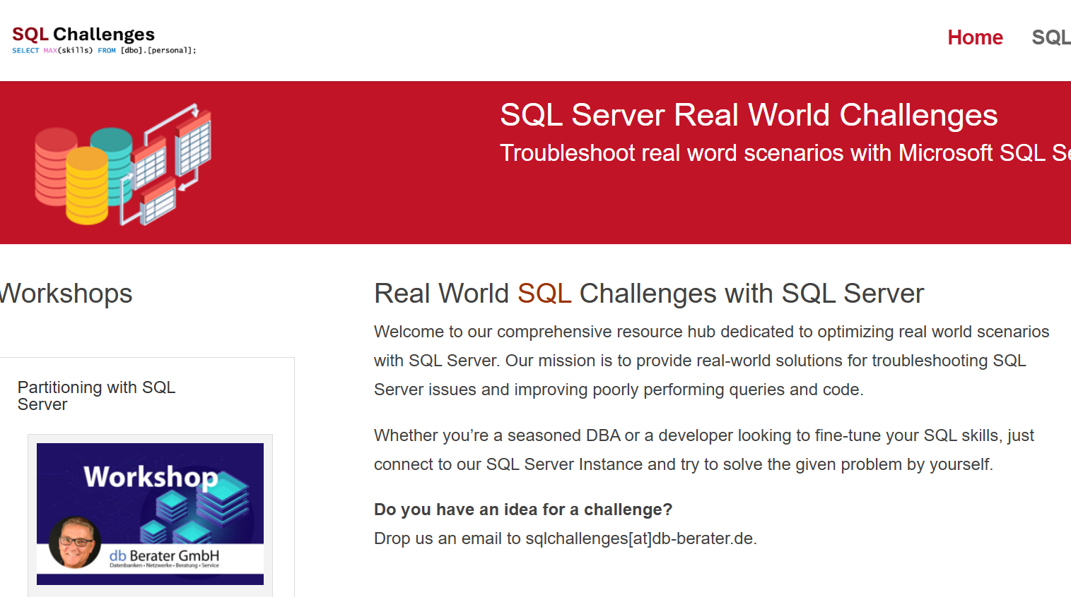
Challenge SQL Server real world scenarios
Get a challenge at least once a month
Connect to a provided SQL Server Instance
Load the challenge scenario
Try to solve it
Blog about your solution
Leave a link in the comments of the challenge to your blog post.
https://sqlchallenges.de

Slide 5
Note
All Use Cases described in this session are based on real-world scenarios and have found the implementation into production.
The customer scenarios have been simplified for this session.

Slide 6
Use Cases for Partitioning
High transactional production environment
The customer is a pharmaceutical company that produces drugs on various (16) production lines.
Every charge must go through a Q&A check that stores the data in the SQL Server Database.
Query Performance Problems
This customer has a big Data Warehouse which gets updated 24/7 all 5 – 10 minutes. Before they can import the data, they must find the last record in a partitioned table. The evaluation of the MAX() value takes between 30 – 45 seconds although there is an index on that attribute
Data Warehouse
The customer is a retail company that loads the key figures (product / sales) of all cash registers into the Date Warehouse every night so that they can create reliable plans for supplying the stores.
Management of big databases
A large company's administrator must re-create indexes and statistics from a 45 TB database every night. The time window is limited, and a way must be found to limit maintenance to the time window.
Furthermore, the SLA determines a downtime for “hot” data within 60 Minutes!

Slide 7
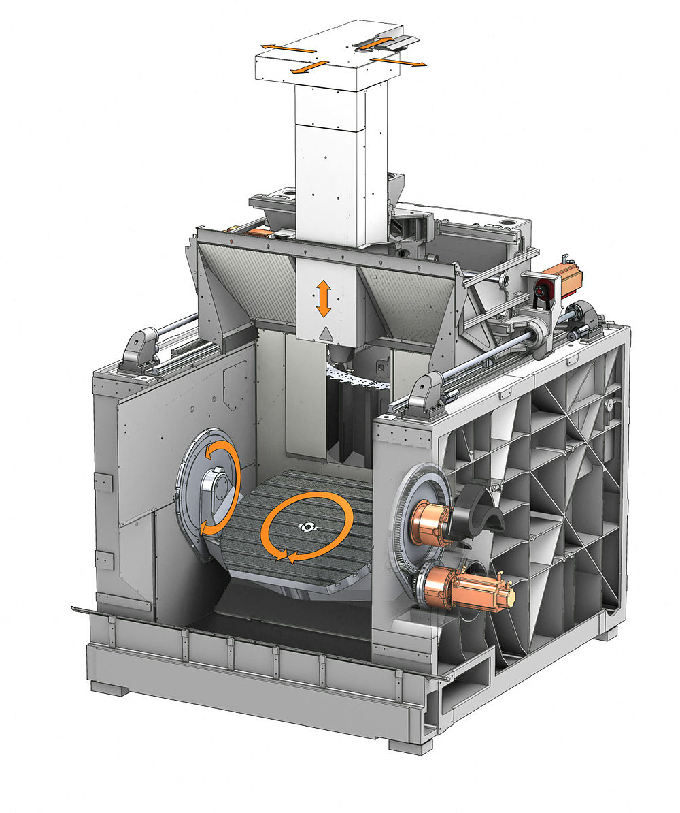


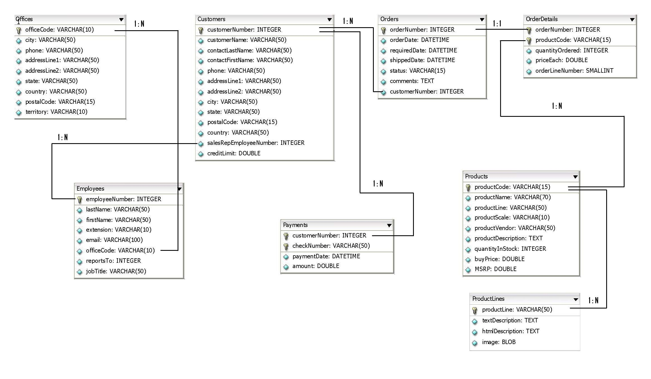
Use Case #1
…
Machine #1
Machine #2
Machine #15
Machine #16
X
INSERT DATA…
Webserver

Slide 8
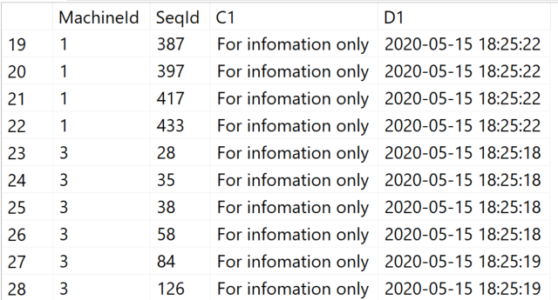
Use Case #1
PRIMARY
File
Write
Problems
The data in the queues grew because SQL Server could not save the data quickly enough!
LATCH-Contention was a problem because the database design could not scale.
Indexes were severely fragmented because the machine's ID was different with each process.

Slide 9

Optimization of High Transactional System

Slide 10
Use Case #1
File
Machine_01
File
Machine_02
File
Machine_03
File
Distribution of data by machine
Reduced PAGELATCH_xx locking duration
Better throughput if data files are on different storage
No index fragmentation because every machine has its separate partition
Machine_15
File
Machine_16
Performance-Improvement: 10% – 25%

Slide 11
Use Cases for Partitioning
High transactional production environment
The customer is a pharmaceutical company that produces drugs on various (20) production lines.
Every charge must go through a Q&A check that stores the data in the SQL Server Database.
Query Performance Problems
The customer has a big Data Warehouse which gets updated 24/7 all 5 – 10 minutes. Before they can import the data, they must find the last record in a partitioned table. The evaluation of the MAX() value takes between 30 – 45 seconds although there is an index on that attribute
Data Warehouse
The customer has a Data Warehouse which collects all data from the cash desks from each supermarket and imports the aggregated values into the DWH for the planning of the distribution of food for the next day. The import starts quick but gets slower as more threads are trying to import new data.
Management of big databases
A large company's administrator must re-create indexes and statistics from a 45 TB database every night. The time window is limited, and a way must be found to limit maintenance to the time window.
Furthermore, the SLA determines a downtime for “hot” data within 60 Minutes.

Slide 12
Query Performance Problems
The customer collects web usage stats for marketing purposes
The data warehouse will be updated in intervals from 5 – 10 mins
Before the data are stored in the Data Warehouse they are collected in a Staging environment
In the next step the customer evaluates the last time stamp in the Data Warehouse to define the new rows which must be imported
The evaluation of the MAX() value takes more than 2 minutes although there is an index on that attribute

Slide 13
Query Performance Problems
.csv
SCHEMA: staging
SCHEMA: demo
staging.raw_data
~13.000.000 rows
demo.orders
Clustered Index:
o_orderkey,
o_orderdate (Partition Key)
~8 mio rows / warehouse
.csv
SELECT MAX(o_orderkey)
FROM demo.orders
OPTION (MAXDOP 4);
GO
.csv
.csv
.csv

Slide 14
Query Performance Problems

Slide 15
Query Performance Problems
In SQL Server, the internal representation of a partitioned table is changed so that the table appears to the query processor to be a multicolumn index with PartitionID as the leading column.
PartitionID is a hidden computed column used internally to represent the ID of the partition containing a specific row.
This allows the Query Optimizer to perform seek operations based on PartitionID on any partitioned table or index.
PARTITION ELIMINATION IS NOW DONE IN THIS SEEK OPERATION.

Slide 16
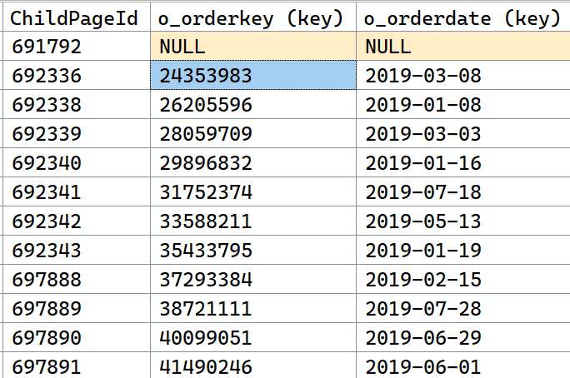
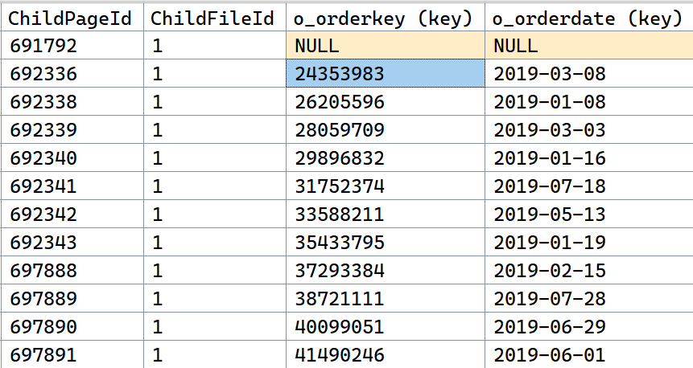
Query Performance Problems
PartitionId (key)

Slide 17
Use Cases for Partitioning
High transactional production environment
The customer is a pharmaceutical company that produces drugs on various (20) production lines.
Every charge must go through a Q&A check that stores the data in the SQL Server Database.
Query Performance Problems
The customer has a big Data Warehouse which gets updated 24/7 all 5 – 10 minutes. Before they can import the data, they must find the last record in a partitioned table. The evaluation of the MAX() value takes between 30 – 45 seconds although there is an index on that attribute
Data Warehouse
The customer has a Data Warehouse which collects all data from the cash desks from each supermarket and imports the aggregated values into the DWH for the planning of the distribution of food for the next day. The import starts quick but gets slower as more threads are trying to import new data.
Management of big databases
A large company's administrator must re-create indexes and statistics from a 45 TB database every night. The time window is limited, and a way must be found to limit maintenance to the time window.
Furthermore, the SLA determines a downtime for “hot” data within 60 Minutes.

Slide 18
Data Warehouse
Calculations on warehouse data are not possible while data from OTHER warehouses are importing.
No parallel execution of the import possible. The customer sees an increasing time for import for each process.
W1
C1
W2
C1
W3
C1
W10
C1
W1
C5
W2
C2
W3
C1
W9
C1
W1
C9
W2
C7
W5
C1
BULK LOAD…
W100
C1
W1
C…
W1
C9
W7
C1
FTP-Server
DB-Server
W150
C1

Slide 19
Data Warehouse
.csv
SCHEMA: staging
SCHEMA: dbo
staging.raw_data
Clustered Index:
warehouse_Id,
cash_Id
~13.000.000 rows
~800.000 rows / warehouse_id
dbo.sales_figures
Clustered Index:
Import_date, (Part),
warehouse_Id,
cash_Id,
article_id
~650,000 rows / warehouse
.csv
.csv
dbo.ImportWarehouseData
.csv
.csv

Slide 20
Data Warehouse
Lock Escalation prevented data records from being entered into the table at the same time
Only when the blocking process releases the lock can the next process write to the table!
Partitioning only works in this scenario if the LOCK_ESCLATION = AUTO option is activated for the table.
X-LOCK
SPID: 53
SPID: 54
SPID: 54
SPID: 56
SPID: 57

Slide 21
Data Warehouse

Slide 22
Use Cases for Partitioning
High transactional production environment
The customer is a pharmaceutical company that produces drugs on various (20) production lines.
Every charge must go through a Q&A check that stores the data in the SQL Server Database.
Query Performance Problems
The customer has a big Data Warehouse which gets updated 24/7 all 5 – 10 minutes. Before they can import the data, they must find the last record in a partitioned table. The evaluation of the MAX() value takes between 30 – 45 seconds although there is an index on that attribute
Data Warehouse
The customer has a Data Warehouse which collects all data from the cash desks from each supermarket and imports the aggregated values into the DWH for the planning of the distribution of food for the next day. The import starts quick but gets slower as more threads are trying to import new data.
Management of big databases
A large company's administrator must re-create indexes and statistics from a 45 TB database every night. The time window is limited, and a way must be found to limit maintenance to the time window.
Furthermore, the SLA determines a downtime for “hot” data within 60 Minutes.

Slide 23
Common SLAs for DBAs
Recovery Point Objective (RPO)
Recovery Time Objective (RTO)
Recovery Level Objective (RLO)
Notes:
The most common place where we see well defined SLAs when dealing with Microsoft SQL Server is in the area of High Availability and Disaster Recovery. These SLAs tend to be easier to define as there are set times and measurable. For HA/DR, the three key SLAs are Recover Point Objective (RPO), Recover Time Objective (RTO), and Recover Level Objective (RLO). We will use HA/DR to define some SLAs that can then be used as example to be used in other areas of database administration. Two other key areas for defining SLAs are Database/Application Performance and Security/Compliance.

Slide 24
Consideration with big databases
Is it required to backup the complete database every night?
How long does the backup take?
How much storage does it consume?
Will differential backups help?
Why not run backups against „hot“ and „changing“ data?
Use partitioning for the read-write filegroups
Same questions come up for RESTORE!!!
Can a full restore of the database cover the SLA?
Partitioning can boost the restore by restoring only read-write filegroups
Restore read-only filegroups later

Slide 25
Restore Database Filegroups

Slide 26
Filegroup Restore
 |  |  | dbo.orders
2020 | … | … | … | … | … | … | … | … | …
2019 | … | … | … | … | … | … | … | … | …
2018 | … | … | … | … | … | … | … | … | …
PartitionFunction()
2000
…
…
…
2016
2017
2018
2019
2020

Slide 27
Filegroup Restore
 |  |  | dbo.orders
2020 | … | … | … | … | … | … | … | … | …
2019 | … | … | … | … | … | … | … | … | …
2018 | … | … | … | … | … | … | … | … | …
PartitionFunction()
2000
…
…
…
2016
2017
2018
2019
2020

Slide 28
THANK YOU!
I am looking forward for your feedback!
Uwe Ricken

Slide 29
Use Cases for Partitioning
High transactional production environment
The customer is a pharmaceutical company that produces drugs on various (20) production lines.
Every charge must go through a Q&A check that stores the data in the SQL Server Database.
Data Warehouse #1
The customer is a retail company that loads the key figures (product / sales) of all cash registers into the Date Warehouse every night so that they can create reliable plans for supplying the stores.
Data Warehouse #2
The customer is a bank that recalculates the valuation of its funds every night. During the calculation, the reports for BaFIN must be created for processed funds because of timeline restrictions.
Management of big databases
A large company's administrator must re-create indexes and statistics from a 4TB database every night. The time window is limited and a way must be found to limit maintenance to the time window.
Furthermore the SLA determines a downtime for “hot” data within 60 Minutes!

Slide 30
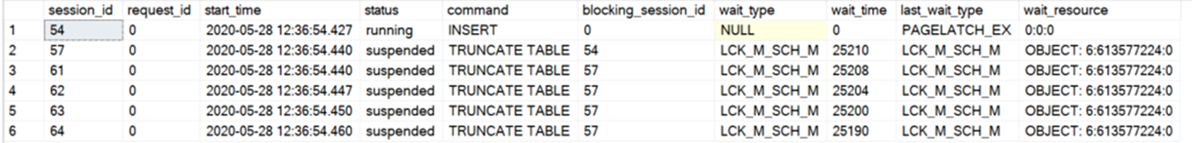
Data Warehouse #2
Problems
TRUNCATE TABLE WITH (PARTITION) causes LCK_M_SCH_M on table
Other processes have to wait when one process inserts data. The INSERT process holds an LCK_IX lock on the table
An LCK_IX lock is incompatible with an LCK_M_SCH_M lock

Slide 31
Data Warehouse #2
Partition (staging)
Fonds_001
Fonds_002
Fonds_003
…
…
…
Fonds_150
dbo.FondsCalculation
Partition_001
Partition_002
Partition_003
…
…
…
Partition_150
ALTER TABLE [source]
SWITCH PARTITION #
TO dbo.FondsCalculation PARTITION #;
Daily transactional activity for each fonds

